Slide 1
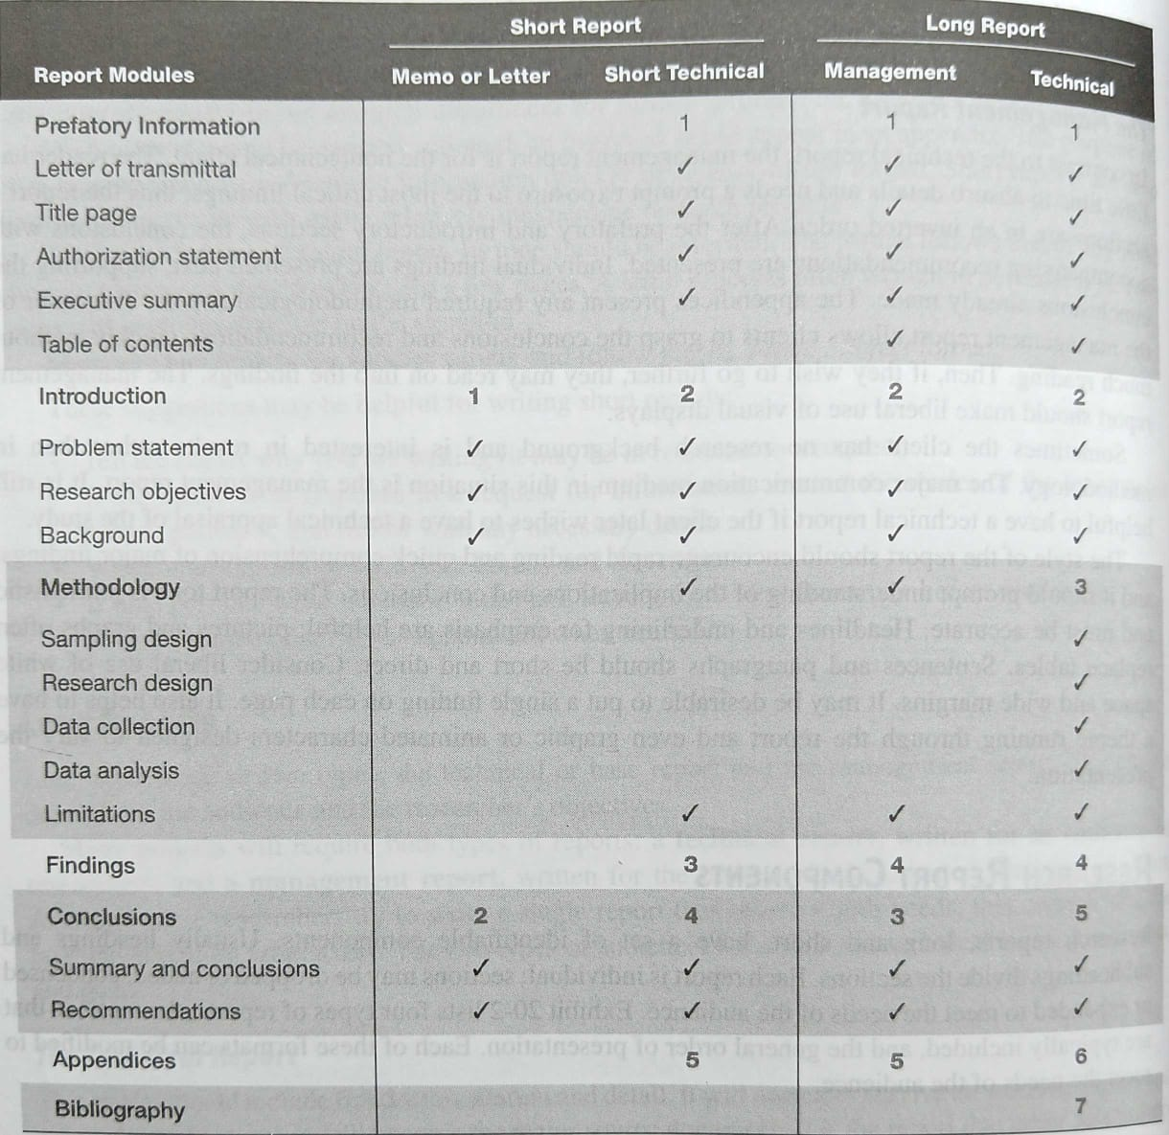
Research Report Section and their order of inclusion

Slide 2
Classification based on information contained
Reports can be classified based on the information they contain as:
Technical Report: A technical report is written for other researchers. In writing the technical reports, the importance is mainly given to the methods that have been used to collect the information and data, the presumptions that are made and finally, the various presentation techniques that are used to present the findings and data.
Popular report: A popular report is formulated when there is a need to draw conclusions of the findings of the research report. One of the main points of consideration that should be kept in mind while formulating a research report is that it must be simple and attractive. It must be written in a very simple manner that is understandable to all. It must also be made attractive by using large prints, various sub-headings and by giving cartoons occasionally.

Slide 3
Classification based on representation
Following are the ways through which the results of the research report can be presented on the basis of representation:
Written report: A written report plays a vital role in every business operation. The manner in which an organization writes business letters and business reports creates an impression of its standard. Therefore, the organization should emphasize on the improvement of the writing skills of the employees in order to maintain effective relations with their customers.
Oral report: Oral presentation of the results that are drawn out of research is considered effective, particularly in cases where policy recommendations are to be made. This approach proves beneficial because it provides a medium of interaction between a listener and a speaker. This leads to a better understanding of the findings and their implications.

Slide 4
Characteristics of a good report
Following are the essential qualities of good report:
A research report is essentially a scientific documentation. It should have a suggestive title, headings and sub-headings, paragraphs arranged in a logical sequence.
Good research report should include everything that is relevant and exclude everything that is irrelevant. It means that it should contain the facts rather than opinion.
The language of the report should be simple and unambiguous. It means that it should be free from biases of the researchers derived from the past experience. Confusion, pretentiousness and pomposity should be carefully guarded against. It means that the language of the report should be simple, employing appropriate words, idioms and expressions.

Slide 5
Characteristics of a good report cont..
The report must be free from grammatical mistakes. It must be grammatically accurate. Faulty construction of sentences makes the meaning of the narrative obscure and ambiguous.
The report must take into consideration two facts. Firstly, for whom the report is meant and secondly, what is his level of knowledge. The report has to look to the subject matter of the report and the fact as to the level of knowledge of the person for whom it is meant. Because all reports are not meant for research scholars.

